Slide 1


Quantum Computing: Introduction and Emulation
Agustin Silva

Slide 2
Quantum Mechanics
History
Classical vs Quantum
Quantum Properties
Quantum Computer
Quantum Devices
Complexity Theory
Quantum Hardware
Programming Languages
Quantum Computing
Quantum Bits
Quantum Gates
Quantum Circuits
Quantum Algorithms
Quantum Teleportation
Deutsch-Jozsa
Grover’s Search
Quantum Fourier Transform
Shor Factorization
Quantum Everywhere
Quantum Cryptography
Quantum Game Theory
Quantum Machine Learning
Quantum Simulations
Emulation of Quantum Algorithms
Trieste - Italy

Slide 3
Quantum Mechanics
History
Classical vs Quantum
Quantum Properties
Quantum Computer
Quantum Devices
Complexity Theory
Quantum Hardware
Programming Languages
Quantum Computing
Quantum Bits
Quantum Gates
Quantum Circuits
Quantum Algorithms
Quantum Teleportation
Deutsch-Jozsa
Grover’s Search
Quantum Fourier Transform
Shor Factorization
Quantum Everywhere
Quantum Cryptography
Quantum Game Theory
Quantum Machine Learning
Quantum Simulations
Emulation of Quantum Algorithms
Trieste - Italy

Slide 4
Quantum Mechanics
History
Classical vs Quantum
Quantum Properties
Quantum Computer
Quantum Devices
Complexity Theory
Quantum Hardware
Programming Languages
Quantum Computing
Quantum Bits
Quantum Gates
Quantum Circuits
Quantum Algorithms
Quantum Teleportation
Deutsch-Jozsa
Grover’s Search
Quantum Fourier Transform
Shor Factorization
Quantum Everywhere
Quantum Cryptography
Quantum Game Theory
Quantum Machine Learning
Quantum Simulations
Emulation of Quantum Algorithms
Trieste - Italy

Slide 5
Quantum Mechanics
History
Classical vs Quantum
Quantum Properties
Quantum Computer
Quantum Devices
Complexity Theory
Quantum Hardware
Programming Languages
Quantum Computing
Quantum Bits
Quantum Gates
Quantum Circuits
Quantum Algorithms
Quantum Teleportation
Deutsch-Jozsa
Grover’s Search
Quantum Fourier Transform
Shor Factorization
Quantum Everywhere
Quantum Cryptography
Quantum Game Theory
Quantum Machine Learning
Quantum Simulations
Emulation of Quantum Algorithms
Trieste - Italy

Slide 6
Quantum Mechanics
History
Classical vs Quantum
Quantum Properties
Quantum Computer
Quantum Devices
Complexity Theory
Quantum Hardware
Programming Languages
Quantum Computing
Quantum Bits
Quantum Gates
Quantum Circuits
Quantum Algorithms
Quantum Teleportation
Deutsch-Jozsa
Grover’s Search
Quantum Fourier Transform
Shor Factorization
Quantum Everywhere
Quantum Cryptography
Quantum Game Theory
Quantum Machine Learning
Quantum Simulations
Emulation of Quantum Algorithms
Trieste - Italy

Slide 7
Quantum Mechanics
History
Classical vs Quantum
Quantum Properties
Quantum Computer
Quantum Devices
Complexity Theory
Quantum Hardware
Programming Languages
Quantum Computing
Quantum Bits
Quantum Gates
Quantum Circuits
Quantum Algorithms
Quantum Teleportation
Deutsch-Jozsa
Grover’s Search
Quantum Fourier Transform
Shor Factorization
Quantum Everywhere
Quantum Cryptography
Quantum Game Theory
Quantum Machine Learning
Quantum Simulations
Emulation of Quantum Algorithms
Trieste - Italy

Slide 8
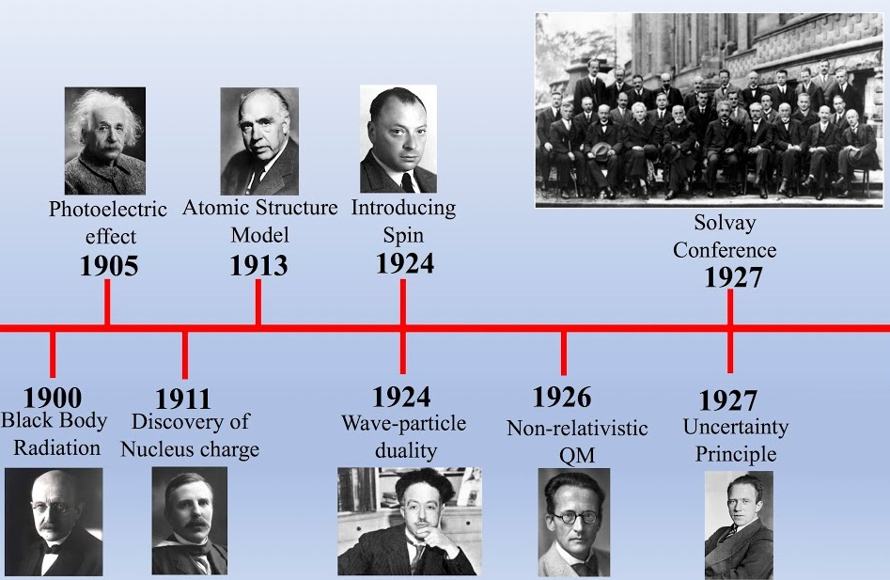
A little bit of History:
Trieste - Italy
Notes:
1990 – Planck
1905 – Einstein
1911 - Rutherford
1913 – Bohr
1924 - de Broglie
1924 – Pauli
1926 – Schrödinger
1927 – Heisenberg

Slide 9
Classical Mechanics
Quantum Mechanics
Macroscopic
Newton’s laws
Continues Energy values
Experiments are deterministic
Certainty in position and momentum
Microscopic
Schrodinger’s equation
Discrete Energy values
Experiments are probabilistic
Uncertainty in position and momentum
Trieste - Italy

Slide 10
Classical Mechanics
Quantum Mechanics
Macroscopic
Newton’s laws
Continues Energy values
Experiments are deterministic
Certainty in position and momentum
Microscopic
Schrodinger’s equation
Discrete Energy values
Experiments are probabilistic
Uncertainty in position and momentum
Trieste - Italy

Slide 11
Classical Mechanics
Quantum Mechanics
Macroscopic
Newton’s laws
Continues Energy values
Experiments are deterministic
Certainty in position and momentum
Microscopic
Schrodinger’s equation
Discrete Energy values
Experiments are probabilistic
Uncertainty in position and momentum
Trieste - Italy

Slide 12
Classical Mechanics
Quantum Mechanics
Macroscopic
Newton’s laws
Continues Energy values
Experiments are deterministic
Certainty in position and momentum
Microscopic
Schrodinger’s equation
Discrete Energy values
Experiments are probabilistic
Uncertainty in position and momentum
Trieste - Italy

Slide 13
Classical Mechanics
Quantum Mechanics
Macroscopic
Newton’s laws
Continues Energy values
Experiments are deterministic
Certainty in position and momentum
Microscopic
Schrodinger’s equation
Discrete Energy values
Experiments are probabilistic
Uncertainty in position and momentum
Trieste - Italy

Slide 14
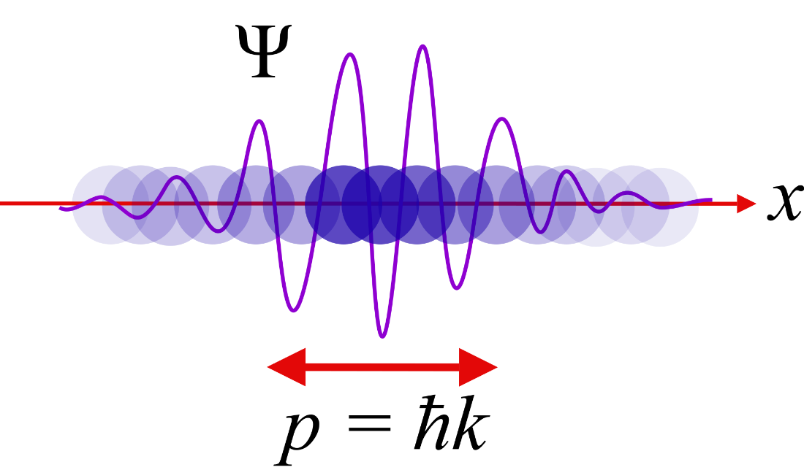
Some Quantum Properties:
Wave Function
Measurement
Superposition
Deconherence
Entanglement
Trieste - Italy

Slide 15
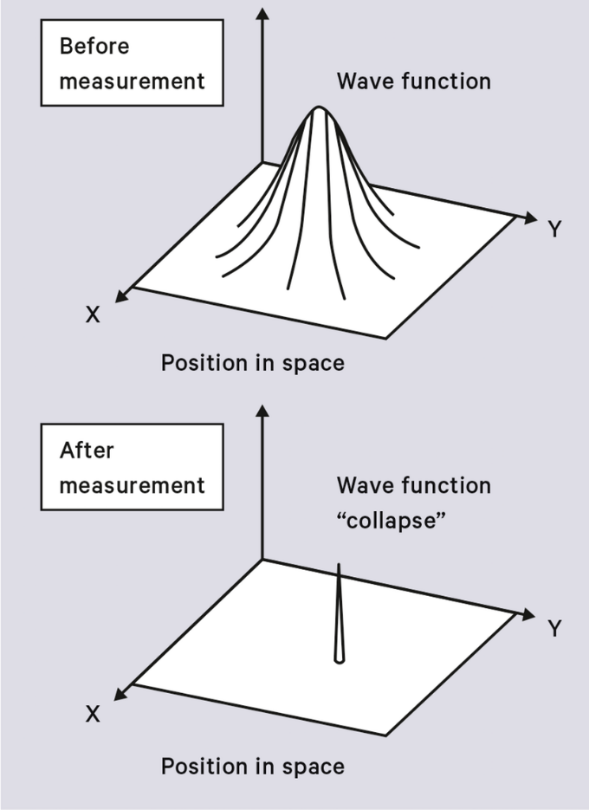
Some Quantum Properties:
Wave Function
Measurement
Superposition
Deconherence
Entanglement
Trieste - Italy

Slide 16
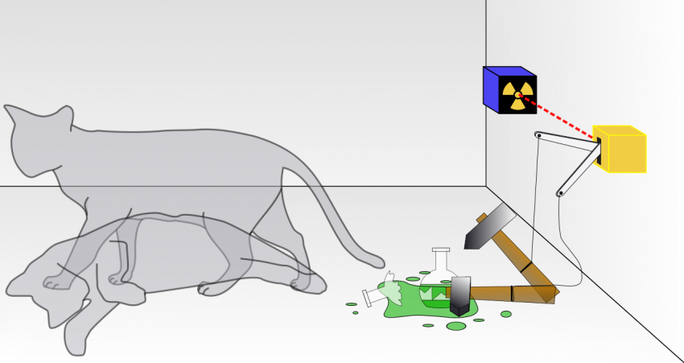
Some Quantum Properties:
Wave Function
Measurement
Superposition
Deconherence
Entanglement
Trieste - Italy

Slide 17
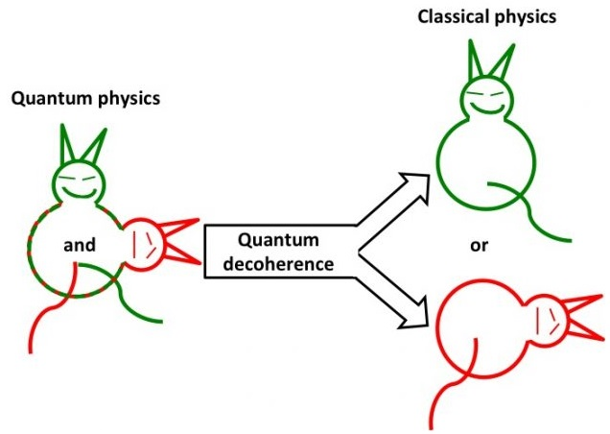
Some Quantum Properties:
Wave Function
Measurement
Superposition
Deconherence
Entanglement
Trieste - Italy

Slide 18
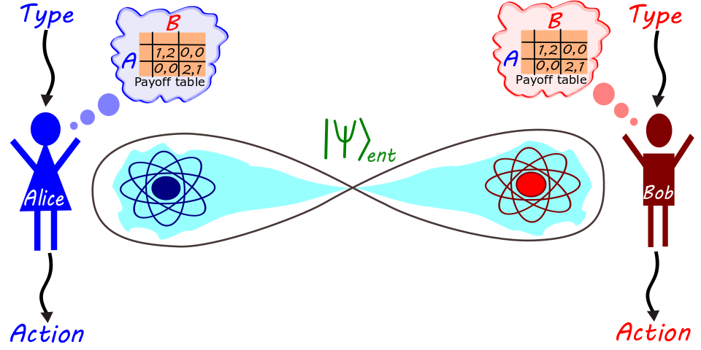
Some Quantum Properties:
Wave Function
Measurement
Superposition
Deconherence
Entanglement
Trieste - Italy

Slide 19
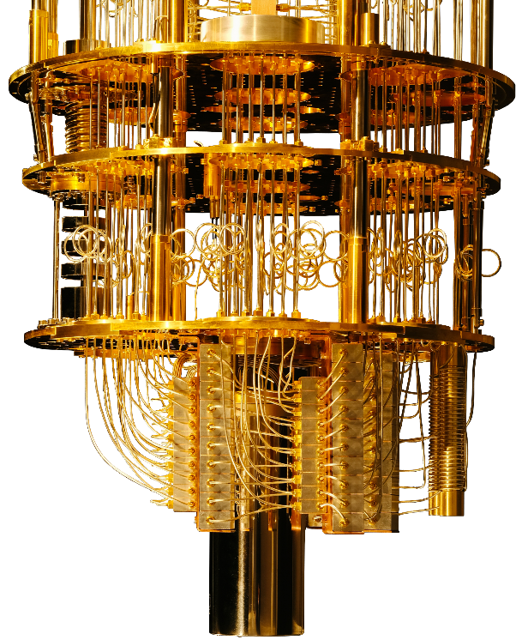
Quantum Computers
Quantum Devices
Complexity Theory
Quantum Hardware
Programming Languages
Trieste - Italy

Slide 20
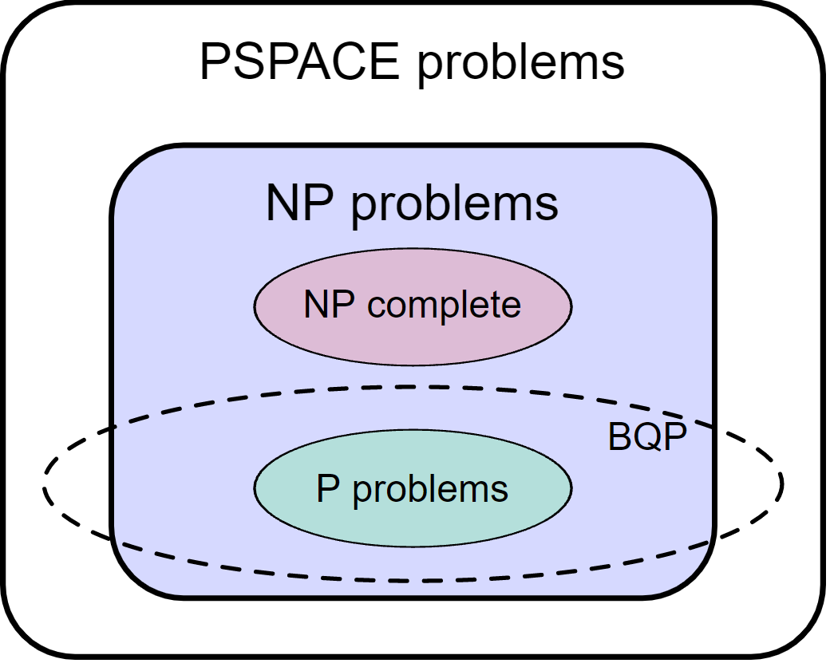
Quantum Computers
Quantum Devices
Complexity Theory
Quantum Hardware
Programming Languages
Trieste - Italy

Slide 21
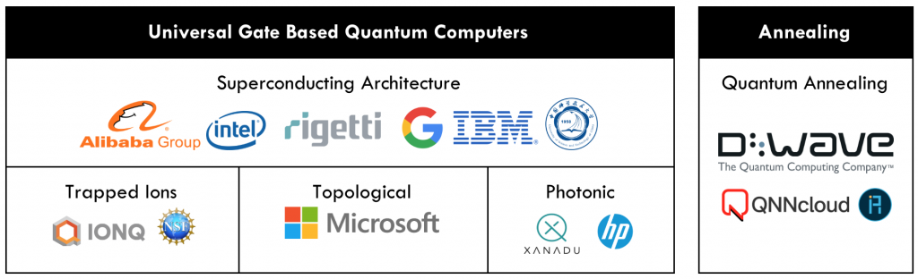
Quantum Computers
Quantum Devices
Complexity Theory
Quantum Hardware
Programming Languages
Trieste - Italy

Slide 22
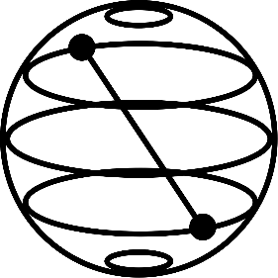




Quantum Computers
Quantum Devices
Complexity Theory
Quantum Hardware
Programming Languages
Trieste - Italy

Slide 23
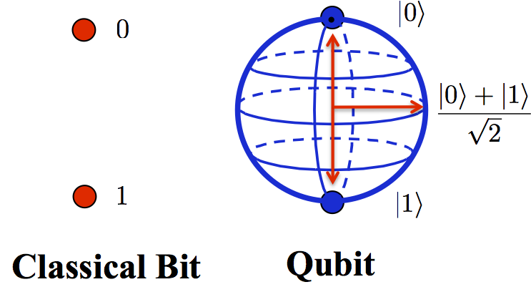
Quantum Bits
Classical vs Quantum bit
Dirac notation
Formal definition
Bloch Sphere
Trieste - Italy

Slide 24
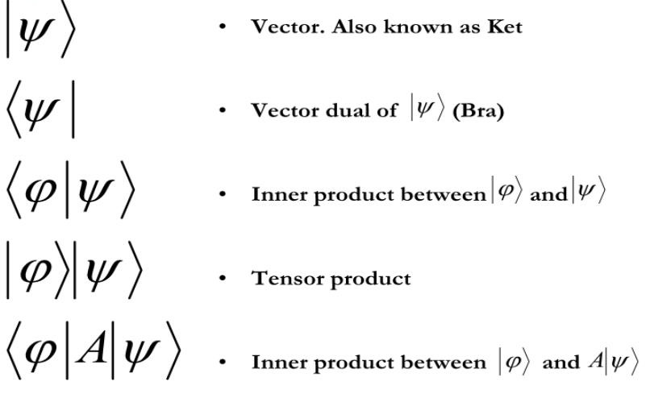
Quantum Bits
Classical vs Quantum bit
Dirac notation
Formal definition
Bloch Sphere
Trieste - Italy

Slide 25
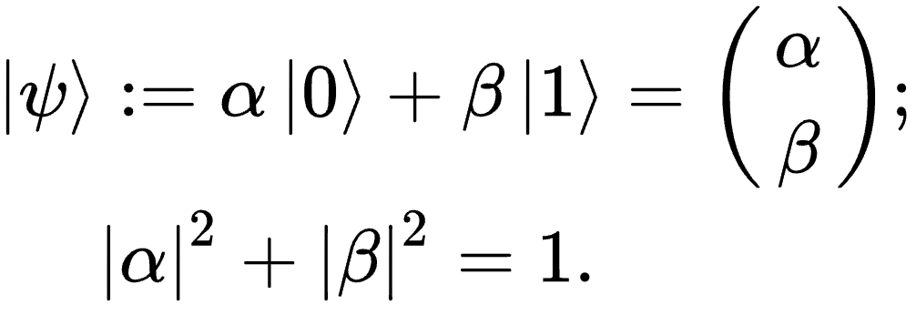
Quantum Bits
Classical vs Quantum bit
Dirac notation
Formal definition
Bloch Sphere
Trieste - Italy

Slide 26
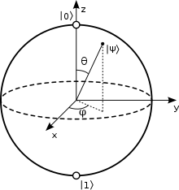
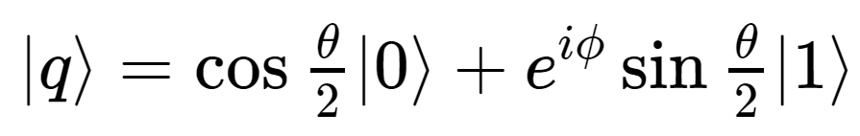
Quantum Bits
Classical vs Quantum bit
Dirac notation
Formal definition
Bloch Sphere
Trieste - Italy

Slide 27
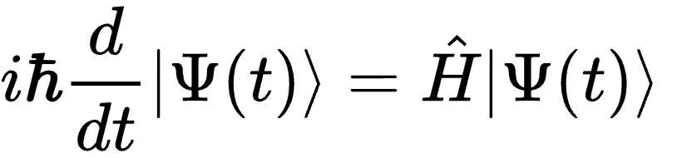
Quantum Gates
Schrodinger equation
Unitary matrix
General one-qubit gate
Multiple qubit gates
Trieste - Italy

Slide 28
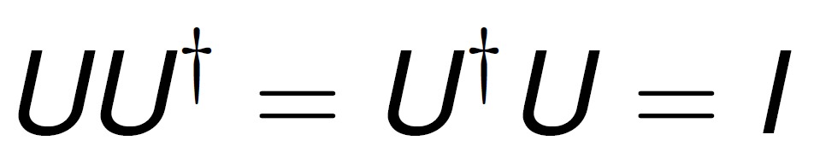
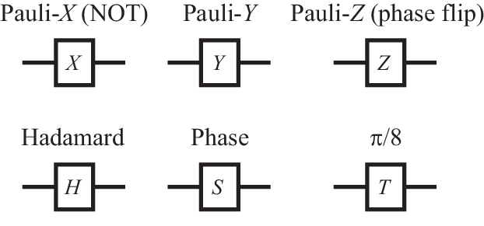
Quantum Gates
Schrodinger equation
Unitary matrix
General one-qubit gate
Multiple qubit gates
Trieste - Italy

Slide 29
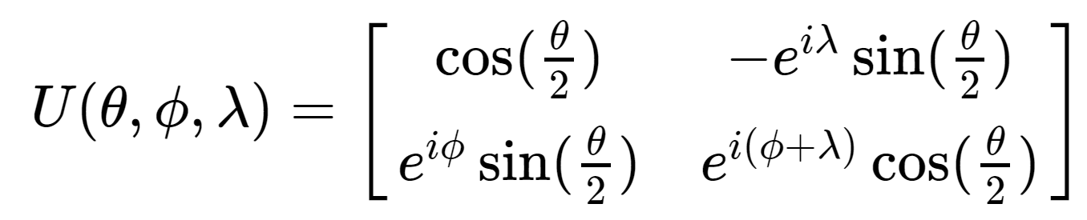
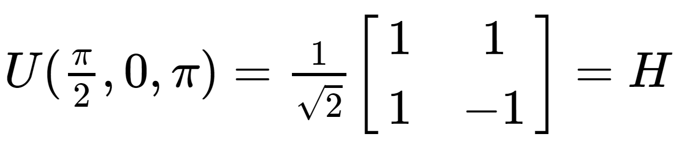
Quantum Gates
Schrodinger equation
Unitary matrix
General one-qubit gate
Multiple qubit gates
Trieste - Italy

Slide 30
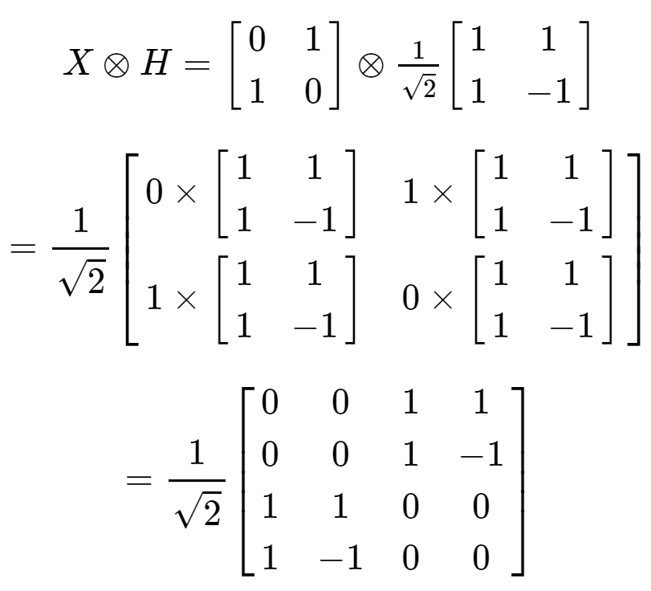
Quantum Gates
Schrodinger equation
Unitary matrix
General one-qubit gate
Multiple qubit gates
Trieste - Italy

Slide 31
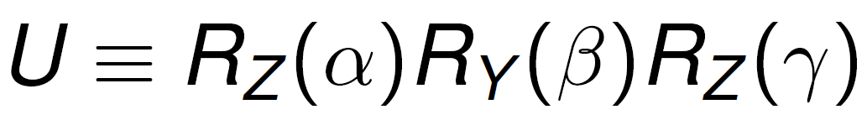



Quantum Circuits
Universal gate set
Linear vs Nonlinear evolution
Measurement gate
No-cloning theorem
Trieste - Italy

Slide 32
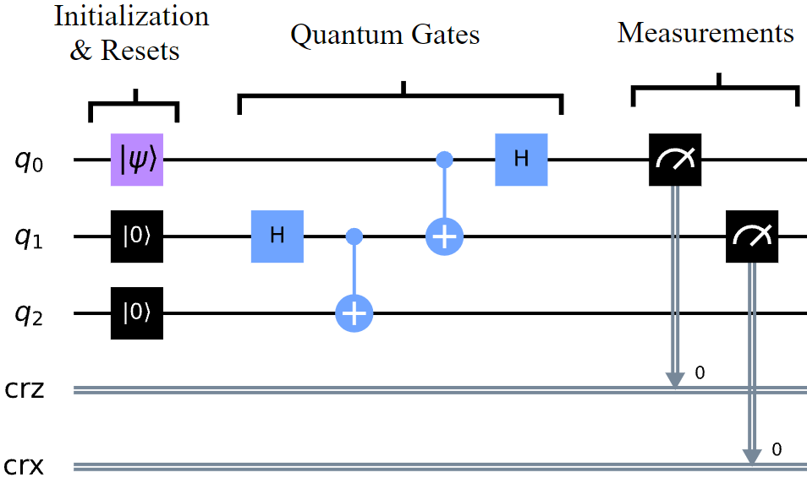
Quantum Circuits
Universal gate set
Linear vs Nonlinear evolution
Measurement gate
No-cloning theorem
Trieste - Italy

Slide 33
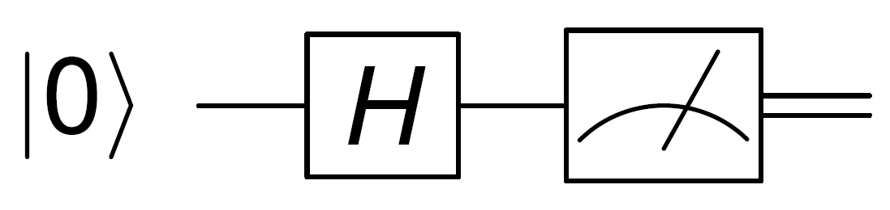
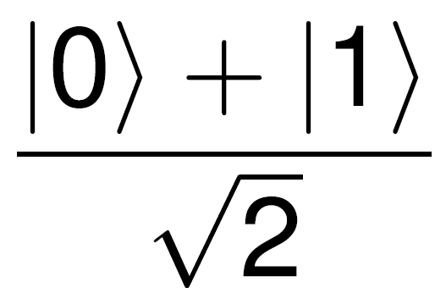
Quantum Circuits
Universal gate set
Linear vs Nonlinear evolution
Measurement gate
No-cloning theorem
Trieste - Italy

Slide 34
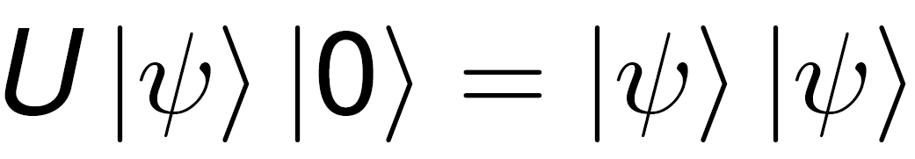
Quantum Circuits
Universal gate set
Linear vs Nonlinear evolution
Measurement gate
No-cloning theorem
<Let’s prove it with what we know>
Trieste - Italy

Slide 35
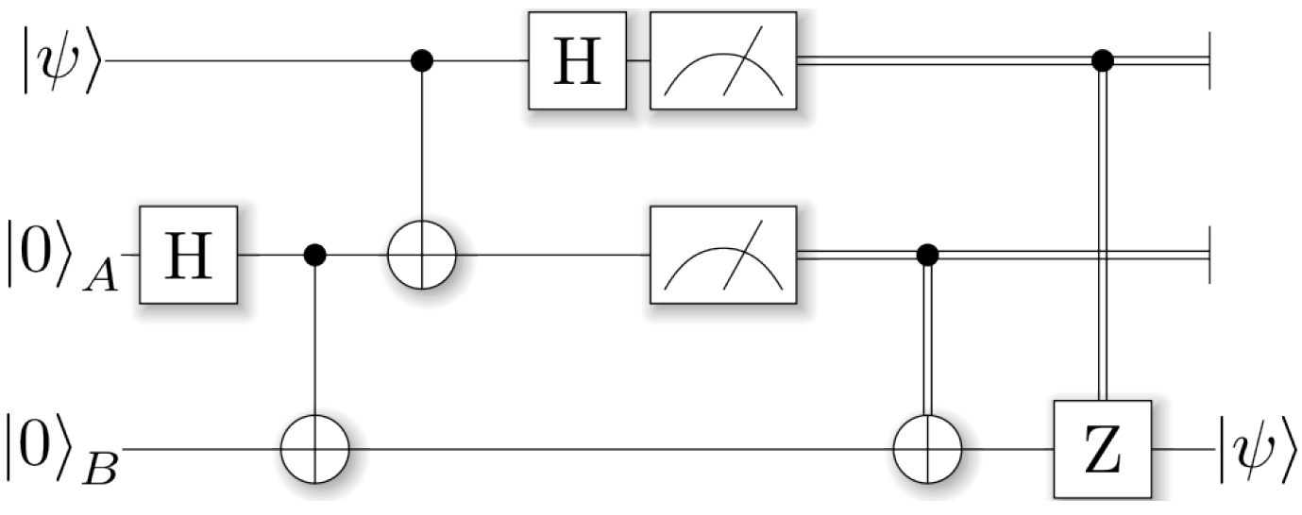
Quantum Algorithms: Quantum Teleportation
Trieste - Italy

Slide 36
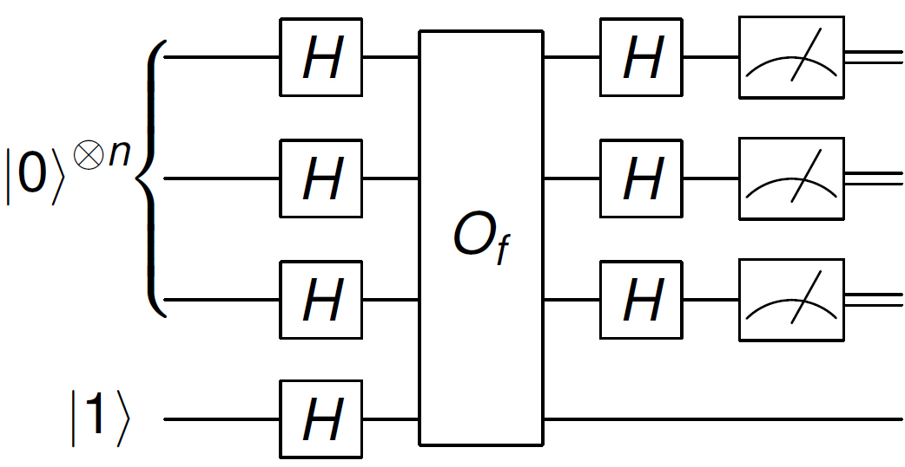
Quantum Algorithms: Deutsch-Jozsa algorithm
Trieste - Italy

Slide 37
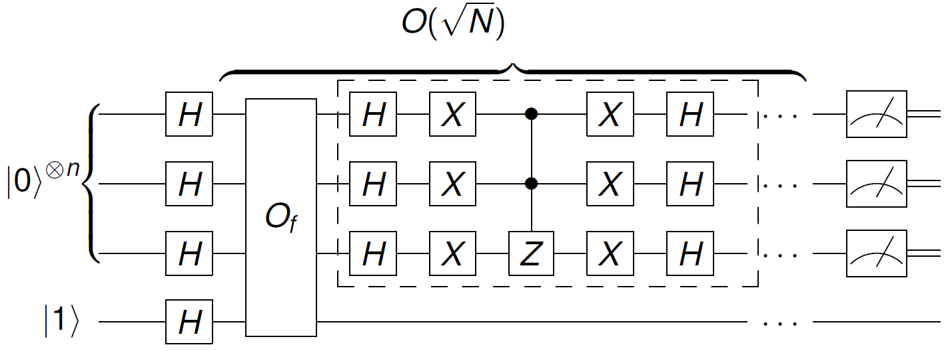
Quantum Algorithms: Grover’s algorithm
Trieste - Italy

Slide 38
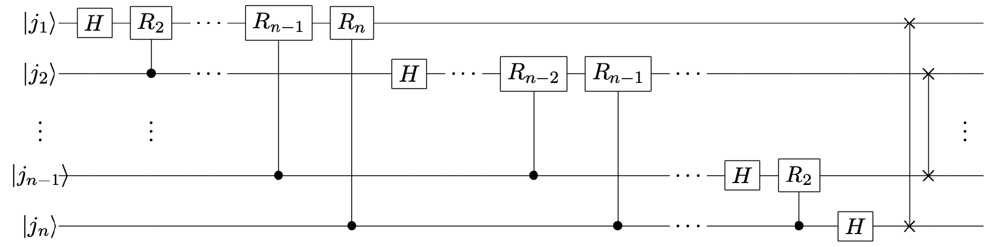
Quantum Algorithms: Quantum Fourier Transform
Trieste - Italy
Notes:
DFT -> N^2 / 2^(2n)
FFT -> N * log(N) / n * 2^n
QFT -> (log(N))^2 / n^2

Slide 39
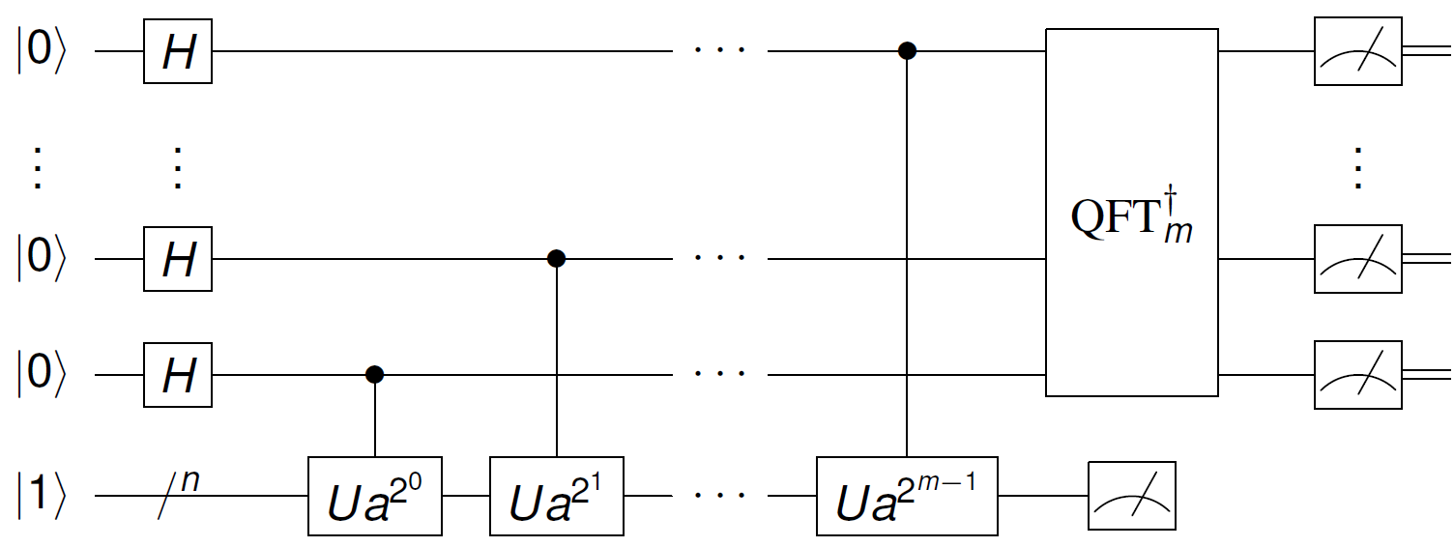
Quantum Algorithms: Shor’s algorithm
Trieste - Italy

Slide 40
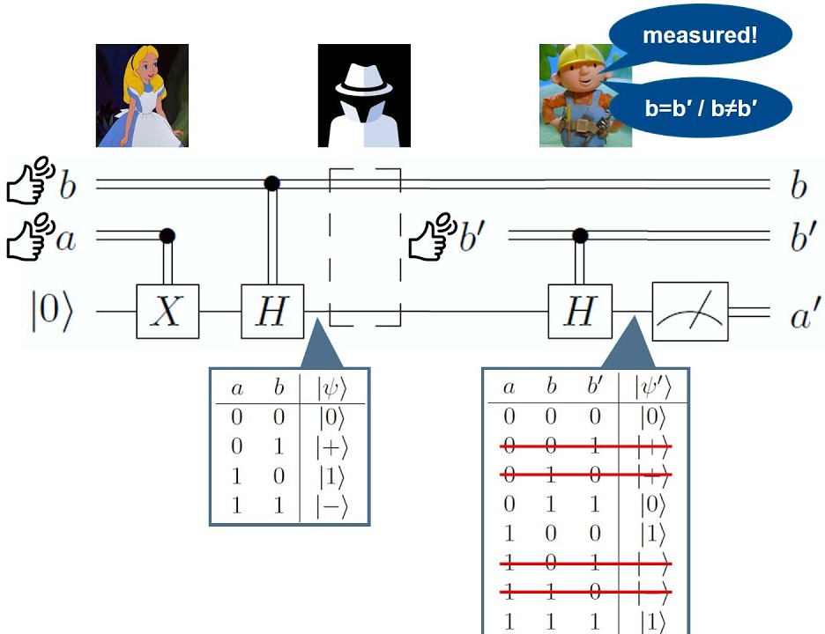
Quantum Cryptography
Trieste - Italy

Slide 41
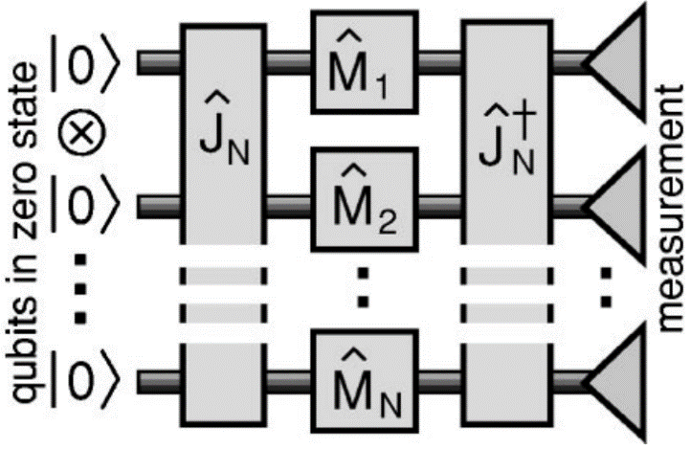
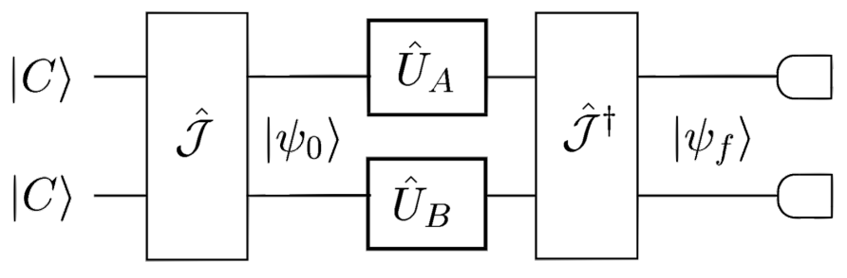
Quantum Game Theory
Trieste - Italy

Slide 42
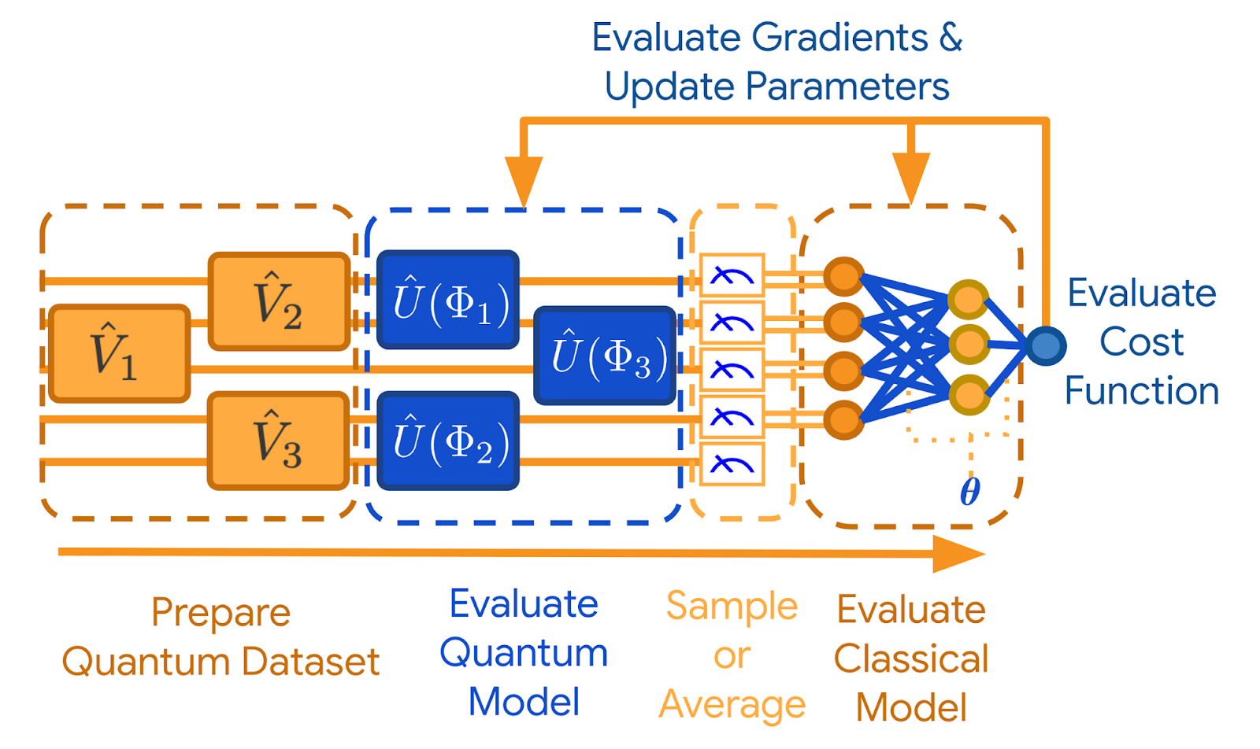
Quantum Machine Learning
Trieste - Italy

Slide 43
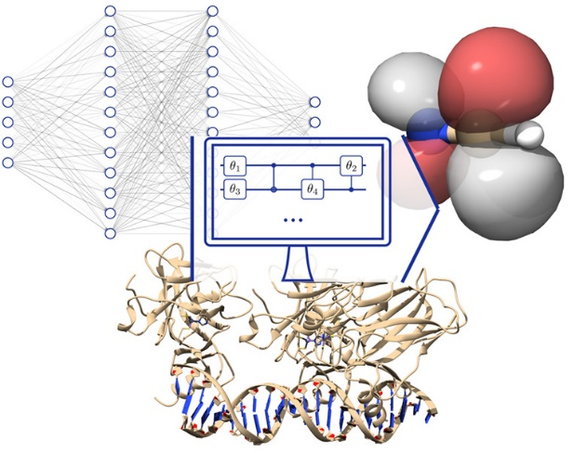
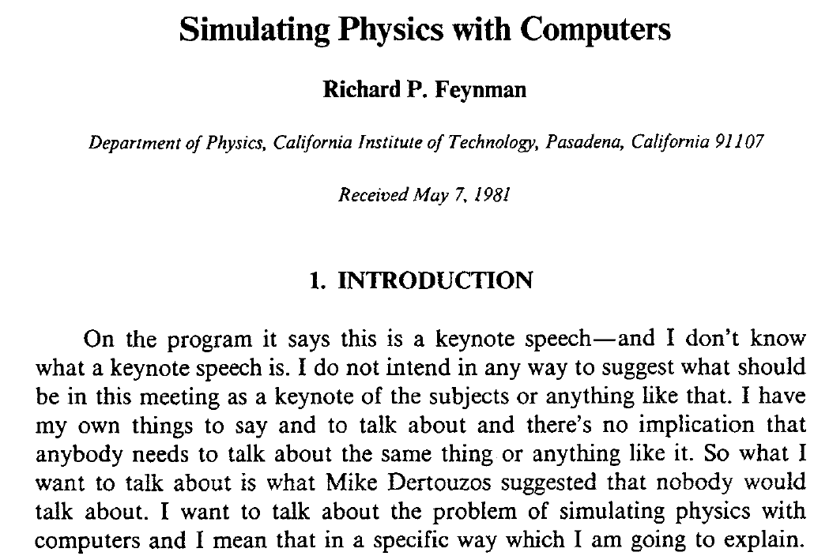
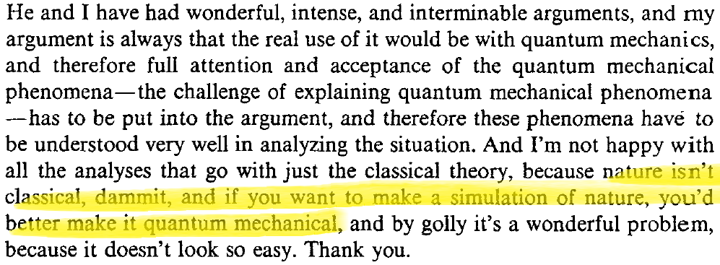
Quantum Simulations
Trieste - Italy

Slide 44
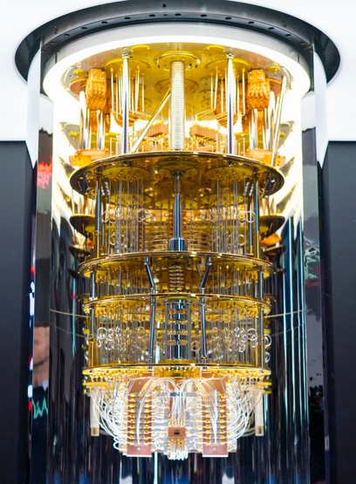
Questions:
Why do we even need quantum computers?
Are QC just trying all possibilities at the same time?
Why are quantum computers so hard to build?
What do we do in the meantime?
Trieste - Italy

Slide 45
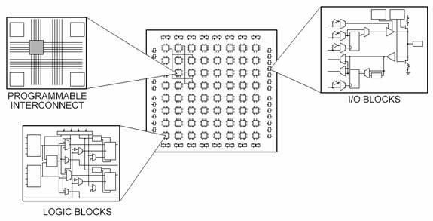
Why FPGAs?
Parallelization capacity
Handling fix point operations
Take advantage of its blocks
Memory manage
Trieste - Italy

Slide 46
Questions? Thank you very much!
Trieste - Italy

